Slide 1

Python Programming
Hospital System Project

Slide 2
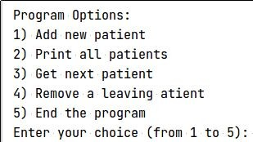
Hospital System
There are 20 different specialization (e.g. Children, Surgery, etc)
For each specialization, there are only 10 available spots [queue]
The program keeps showing this menu of options

Slide 3
Hospital System: Adding a patient
To add a patient: provide which specialization, name and status
Specialization: 1-based integer (e.g. 1 to 20)
Status is 0 (normal), 1 (urgent) and 2 (super urgent)
Normal patient is added to the end of the current queue of this specialization
Urgent patient is added after current urgents patients & before normal patients
Super-urgent patient is added after current super-urgent patients & before urgent/normal patients
Read the requested specialization [1-20].
Read his name and status (0 = regular, 1 urgent)
If 10 patients exist in this specialization, apologize and don’t accept.

Slide 4
Hospital System
Get next patient
Given a specialization, return the top patient of the queue
And remove from the queue
If no patient: just inform the Dr about that
Remove a leaving patient
A patient may decide to leave before seeing a doctor
Provide specialization and name
If no such a person: inform about that

Slide 5
Dummy Data & Testing
When we build new systems, typically no user data
We may write a function that adds dummy data to the system
Write a dummy function that adds initially several scenarios
E.g. a specialization with 10 persons of all different statuses
Eg. another specialization with a specific status
E.g. another one with 2 out of the 3 statuses
Overall: different scenarios help you verify the correctness
Testing
Think in all possible scenarios that activate every line of code you wrote and verify all needed cases
Testing is an important aspect in software engineering

Slide 6
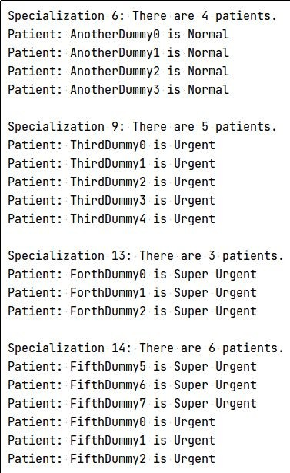
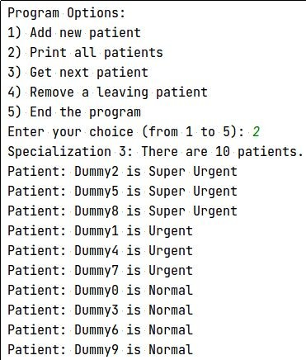
My Dummy Data

Slide 7
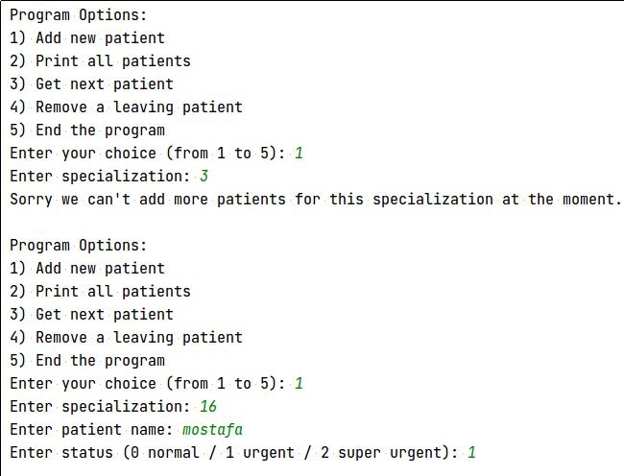


Slide 8
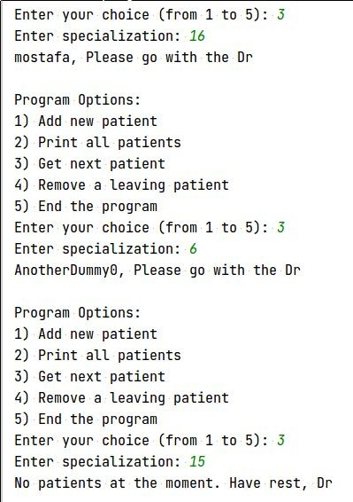

Slide 9
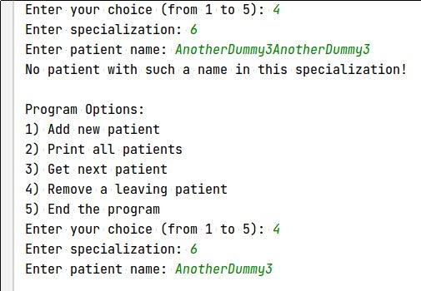


Slide 10
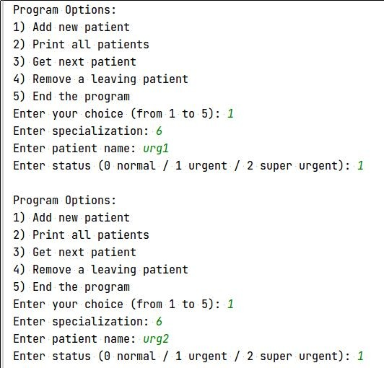
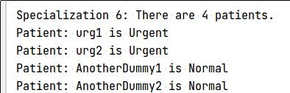

Slide 11
